Slide 1
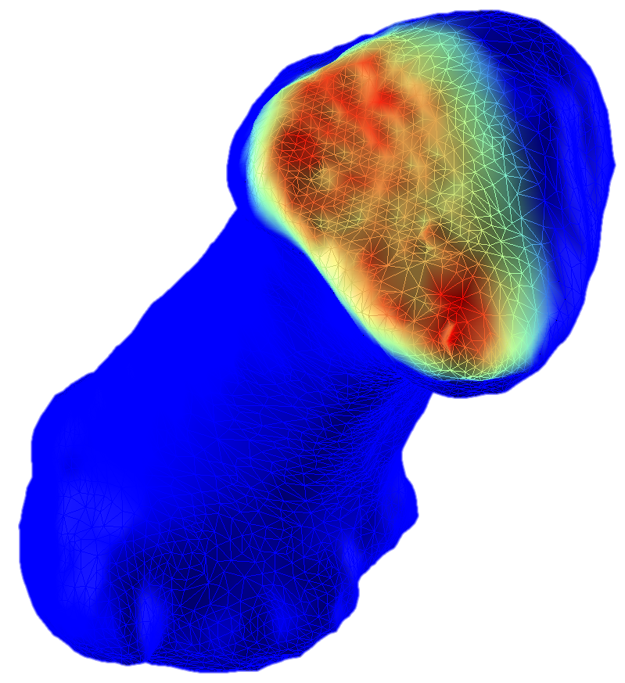

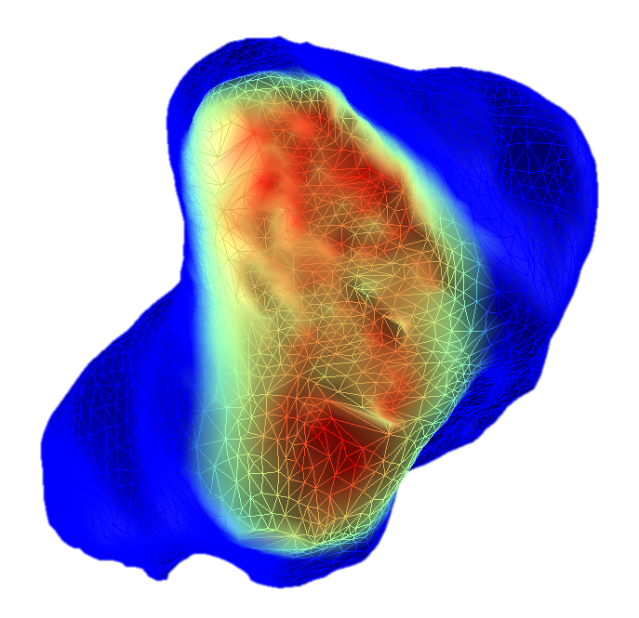
THUMB CONTACT BIOMEHANICS

Slide 2
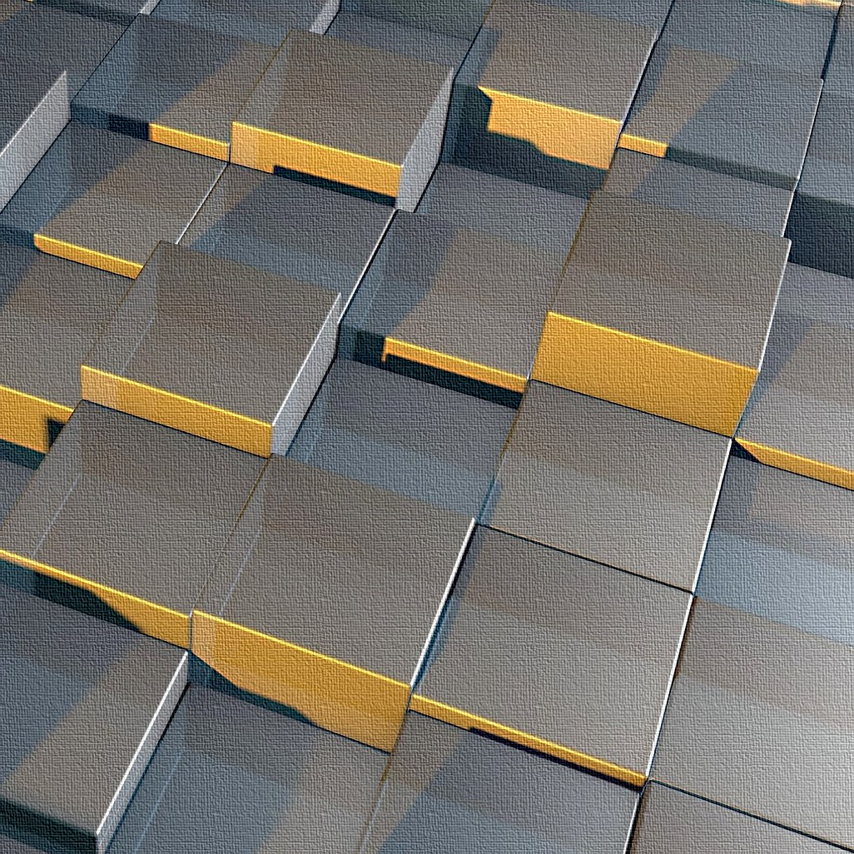
3D
TRANSFORMS

Slide 3
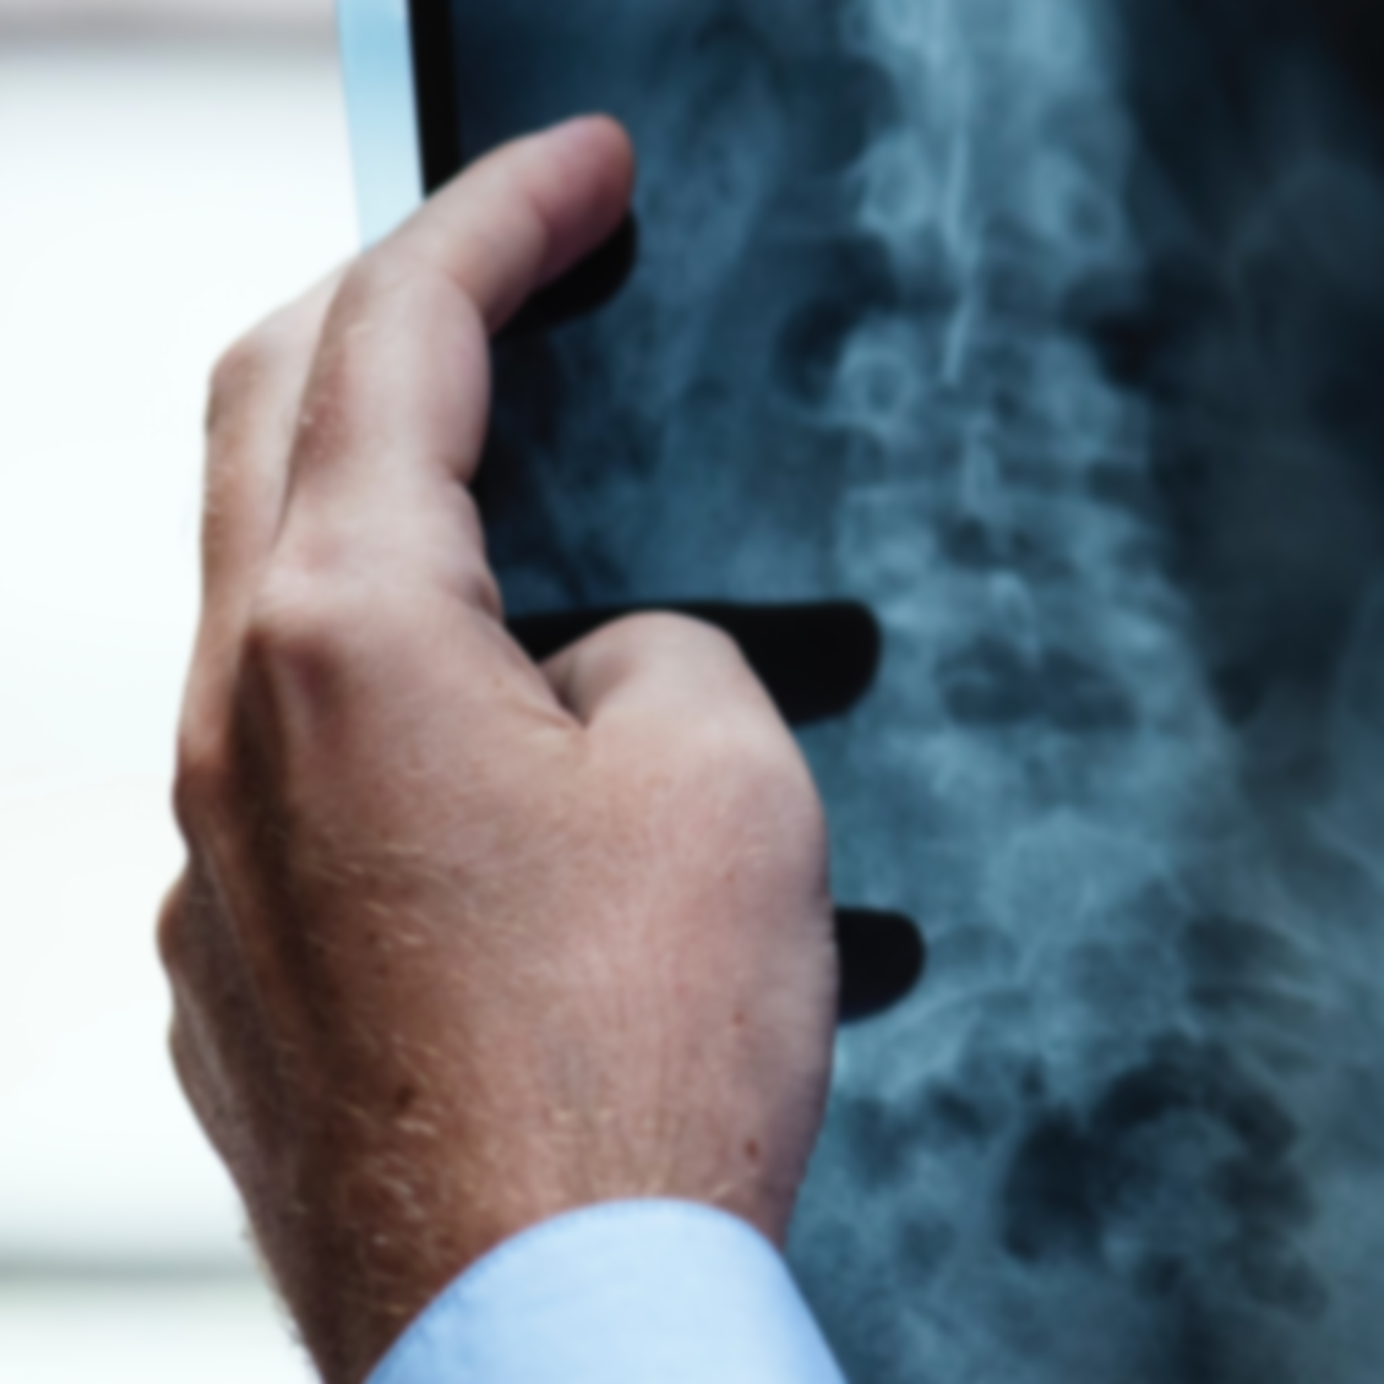
HAND MOBILITY
VIA
MEDICAL IMAGING

Slide 4
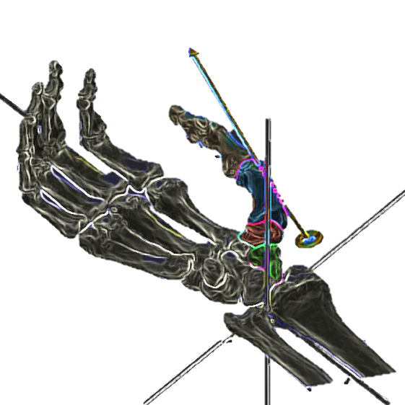
THUMB MOBILITY
VIA
DYNAMIC MEDICAL IMAGING

Slide 5
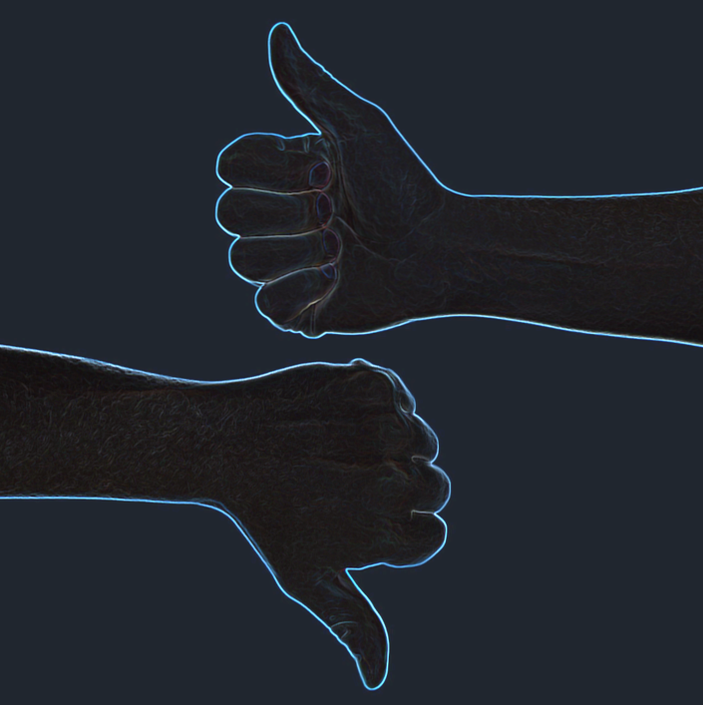
HEALTHY
HEALTHY
VS
ARTHRITIC

Slide 6
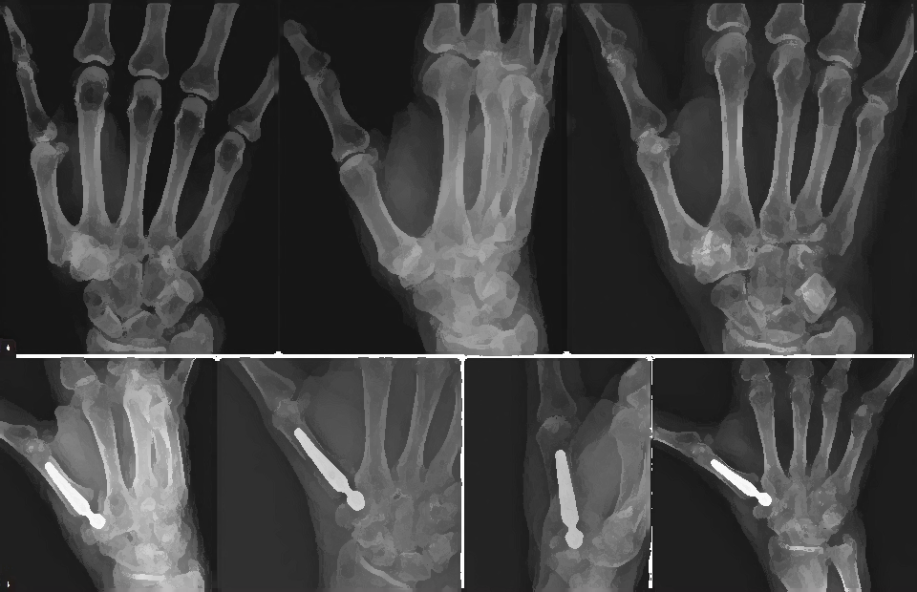
THUMB MOBILITY
PRE- VS POST- IMPLANT

Slide 7
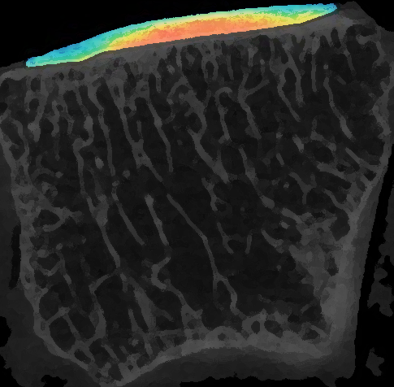
CARTILAGE PROPERTIES VIA MEDICAL IMAGING

Slide 8
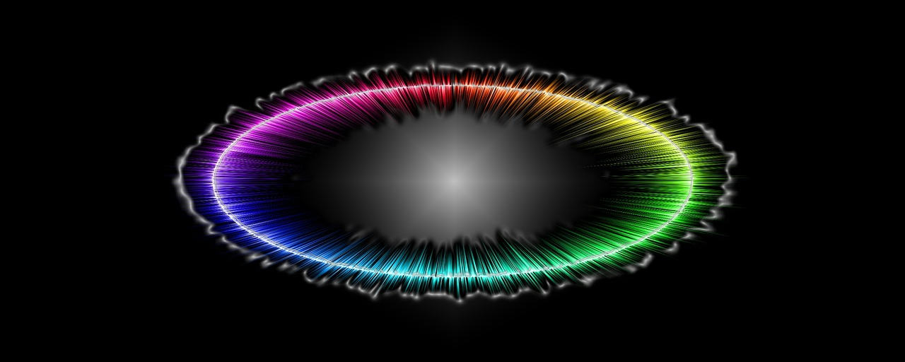
SIGNAL
PROCESSING

Slide 9
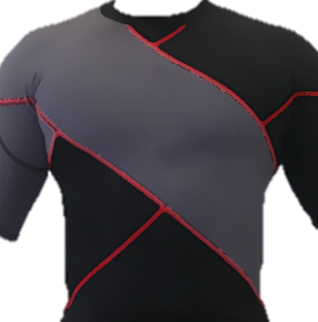
IMPACT OF
COMPRESSION
GARMENTS

Slide 10

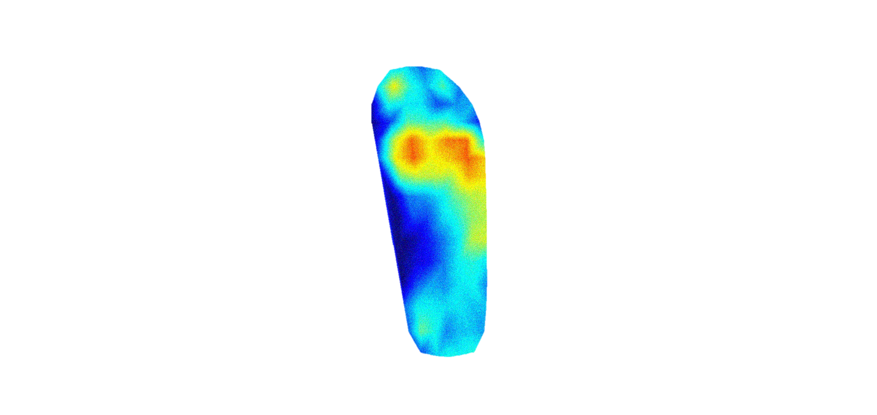
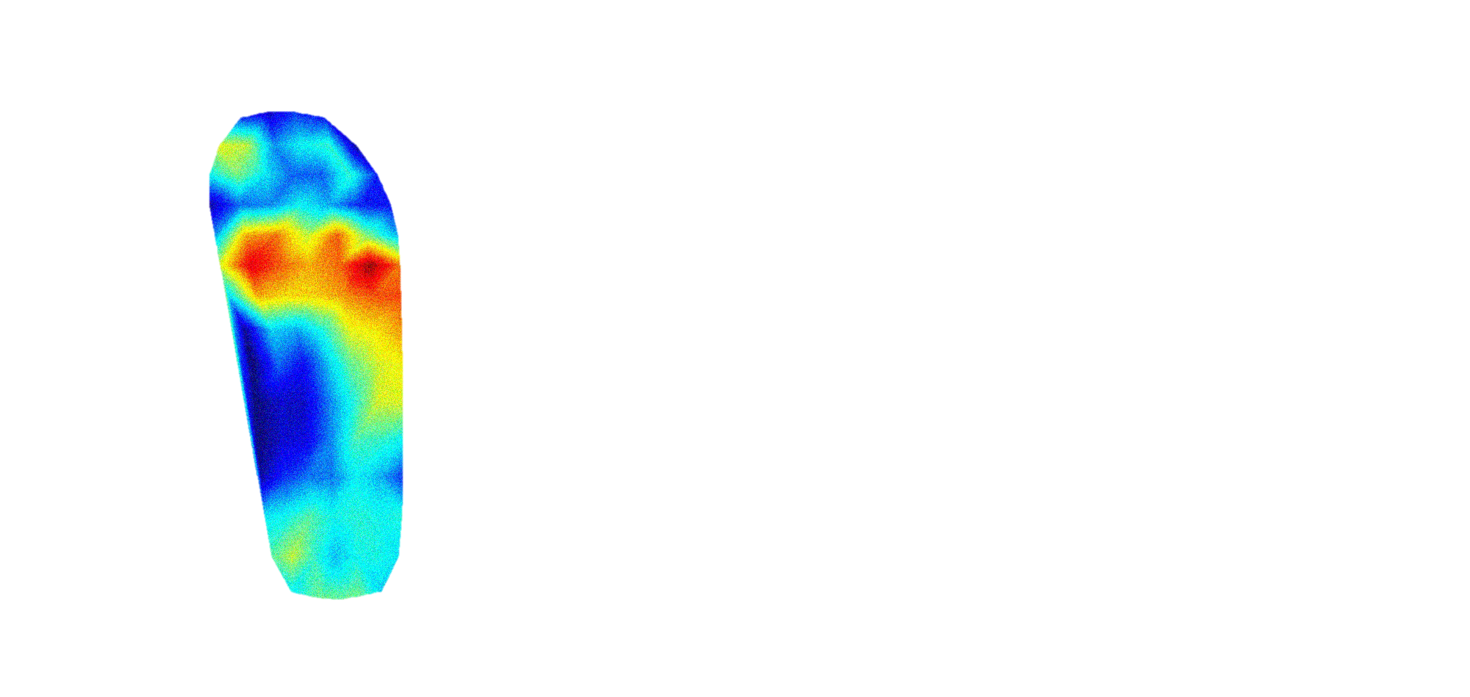
FOOT PRESSURE MEASUREMENT TECHNOLOGIES

Slide 11
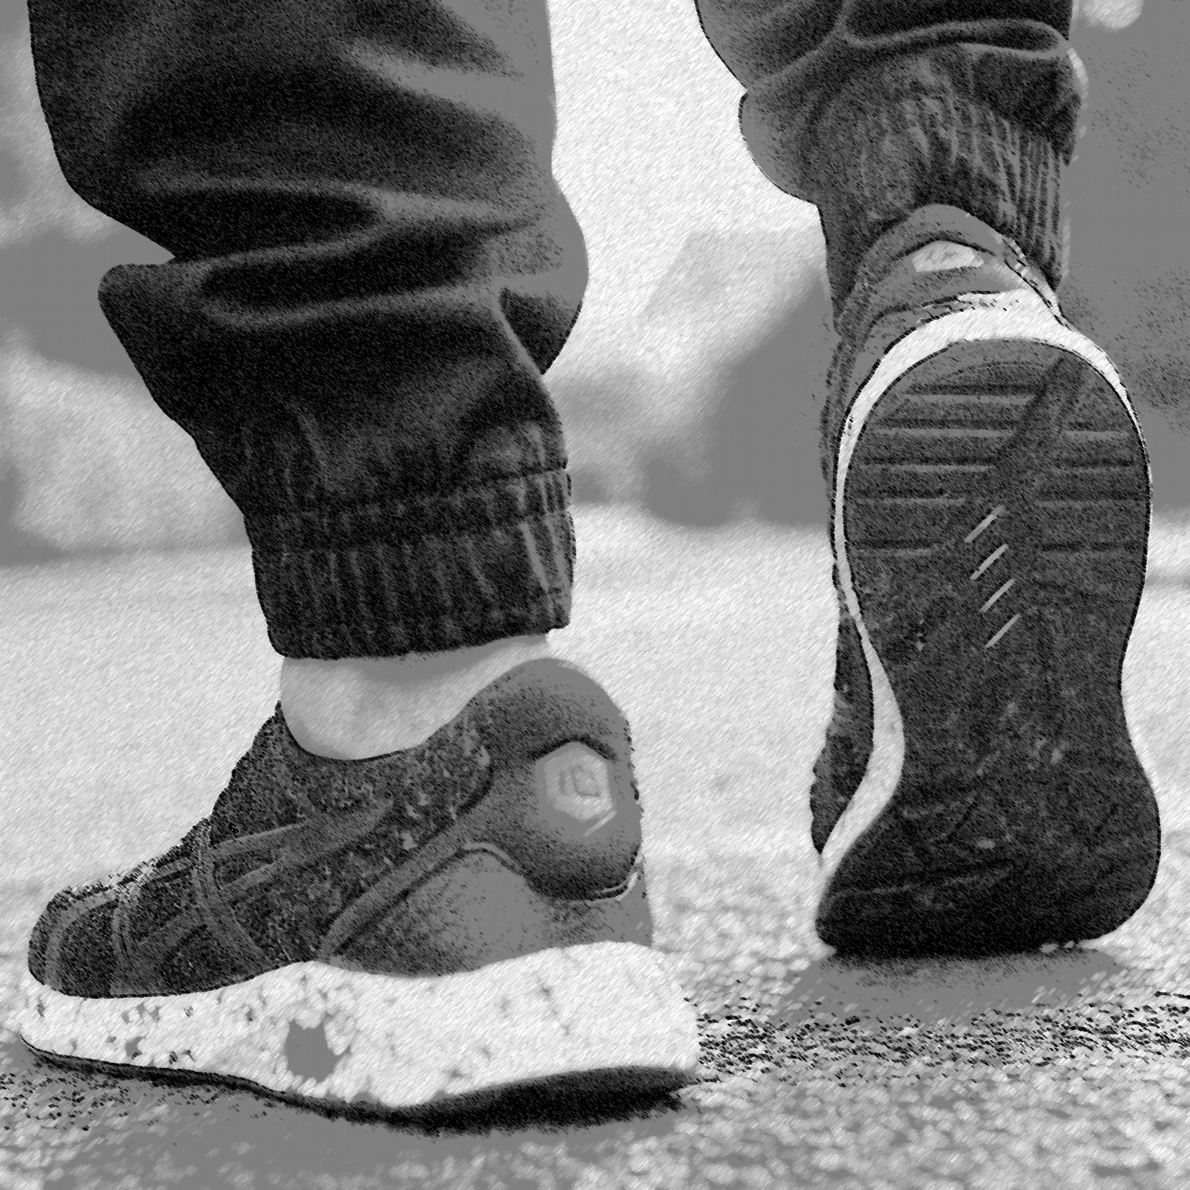
INSOLES IMPACT ON LOWER LIMBS FATIGUE

Slide 12

MACHINE
LEARNING

Slide 13
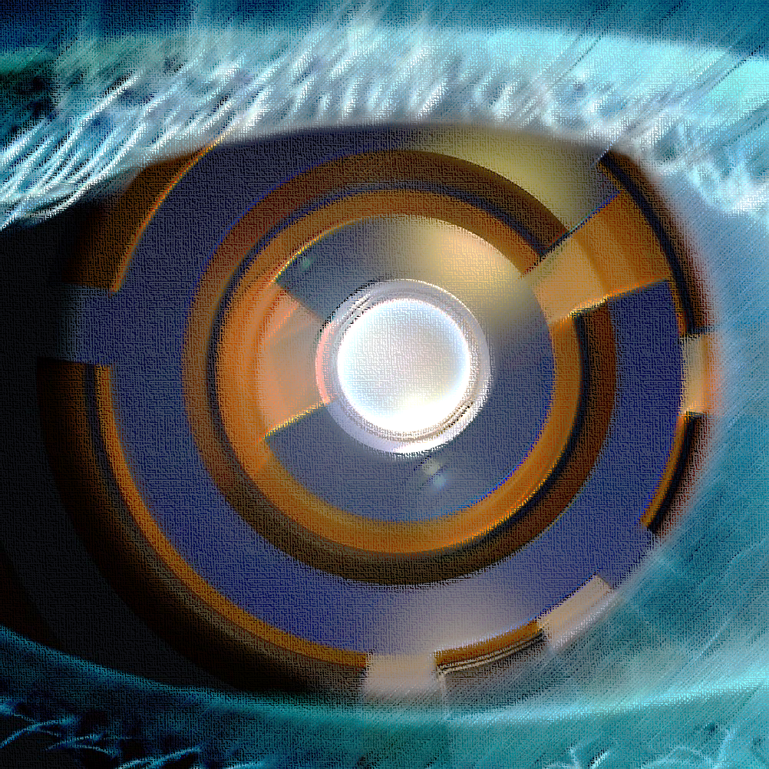
COMPUTER
VISION

Slide 14
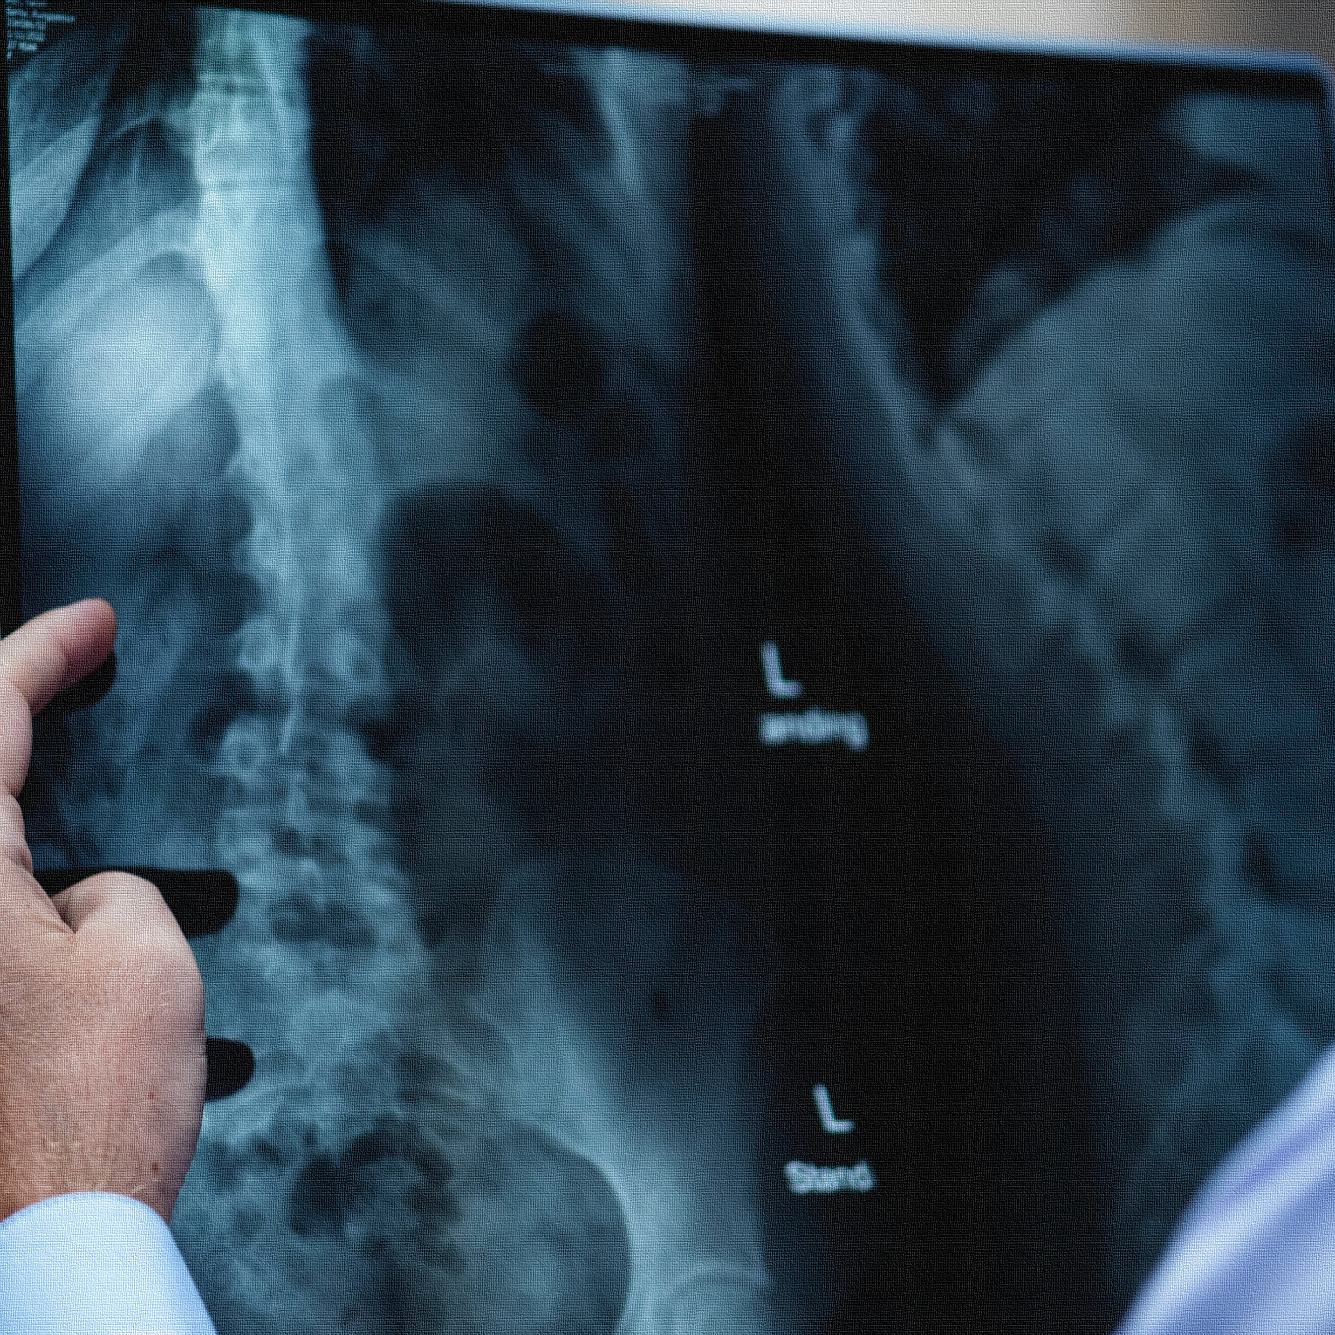
MEDICAL
IMAGING

Slide 15
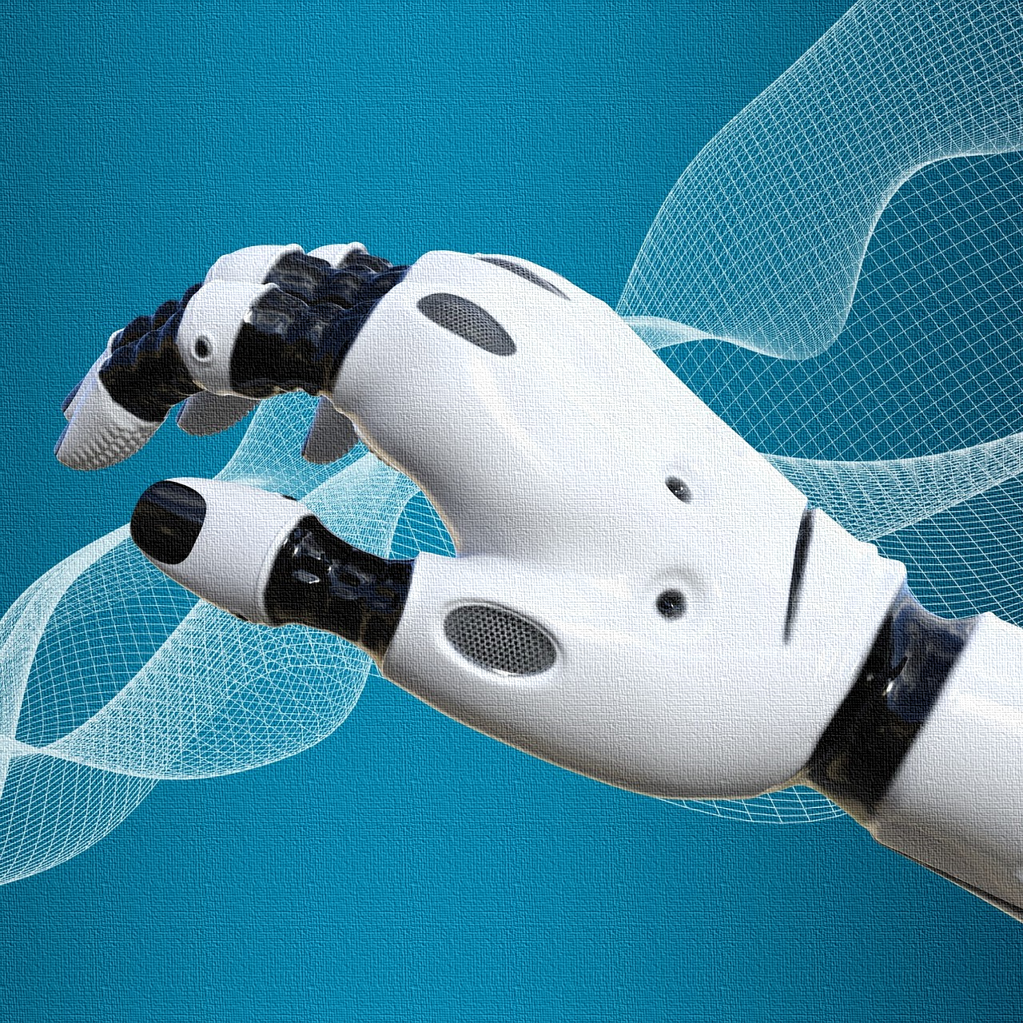
COMPUTER
MODELING

